Slide 1
Prediction of target SLA adherence
Presented by
Isuri Chandrasekera

Slide 2
BIO
Profile and Portfolio
Experience in Retail / IT for over 15 years.
Experience in both Large and small scale Retail Management
Exposure to Data Science and AI
Education
Bachelor of Information Technology
(Computer Science and Software Development) – Deakin University
CCNA 1 to 1V Certification
(WAN Technologies, Switching Basics and intermediate Routing,
Router and Routing Basics, Networking Basics)
SQL SERVER 2008 for Business Intelligence

Slide 3
Agenda
Business Problem
Exploring data analysis
Project pipeline
Model evaluation
Further prospects
Conclusion
Notes:
The agenda for today is,

Slide 4
Overview
Most businesses profitability relies on Target SLAs.
Making data driven decisions affects all identified five core business systems such as,
Sales & Marketing.
Quality & Product/Service Delivery.
Product Development.
Accounting & Technology.
Administrative (Management, HR & Finance)
Provides an assurance that the seller can respond to a customer query within a given time period.
Allows to highlight where the system needs further data to have a complete picture of the business

Slide 5
What is SLA?
Service Level Agreements (SLAs) define the level of service a customer can expect from a seller or a marketplace.
One of the most important service clauses in an SLA is an assurance that the seller will respond to a customer query within a given time period

Slide 6
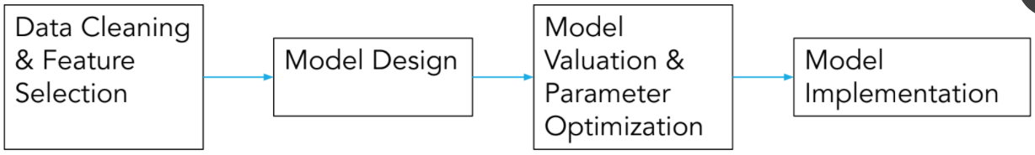
Project pipeline
141,712 rows x 36 features
Logistic Regression
Support Vector Classifier
Decision Tree
Random Forest
Gaussian Naive Bayes
CatBoostClassifier
Select best model
& tuning parameters
Split data into
70% train – 30%
test
Notes:
This is the project pipeline which was followed, throughout this project.
Initial dataset consisted of 141,712 rows x 36 features

Slide 7
Incident management process enriched event log
Answering the question
‘Can we
predict the time frame accurately
for a new job?’
Notes:
Can we predict the time frame accurately for a new job?
Let me explain what I have discovered using the dataset ‘Incident management process enriched event log’

Slide 8
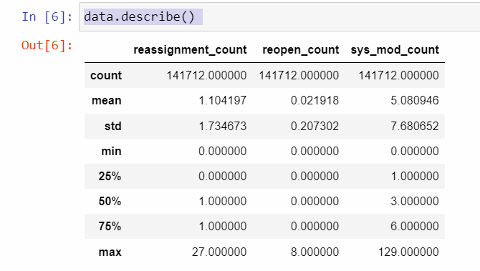
Summery of the data set
By default, describe() computes and only shows statistics for the numeric variables.
count
mean
standard deviation
the minimum and maximum
the 25th, 50th, and 75th percentiles
Notes:
By default, describe() computes and only shows statistics for the numeric variables.
It is clear that there are three of them in the data set.
It projects count, mean, standard deviation, the minimum and maximum, the 25th, 50th, and 75th percentiles

Slide 9
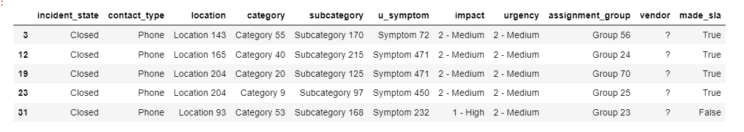
All columns known as a new job and prediction variable.
Notes:
This shows all columns known as a new job and the prediction variable made_sla.

Slide 10
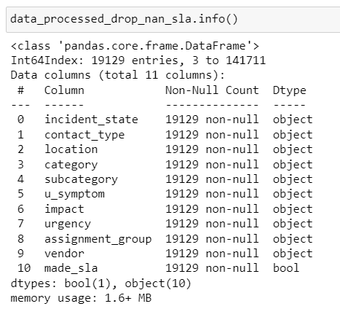
Exploring the filtered dataset
Notes:
Filtered dataset features consists of object and boolean data types.
Non-Null count is same for all features.
Memory usage of 1.6MB

Slide 11
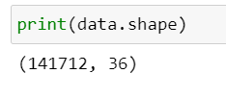

Number of rows and columns of the data set
Before
After
Notes:
This indicates number of rows and columns before and after feature selection

Slide 12
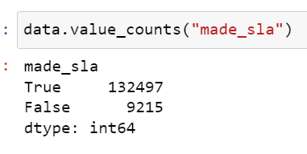
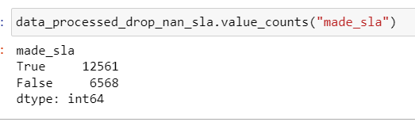
Data is lost due to filtering, it is ignorable.
Before | After

Slide 13
Understanding the dataset and identifying what to expect
incident within the target SLA | identified as exceeded | True Positive
incident within the target SLA | not identified as exceeded | True Negative
incident exceeded the target SLA | identified as exceeded | False Positive
incident exceeded the target SLA | not identified as exceeded | False negative
Notes:
When the target SLA has exceeded and it is not identified, that becomes a problem.
So we need to make sure false negative is kept to its minimum.

Slide 14
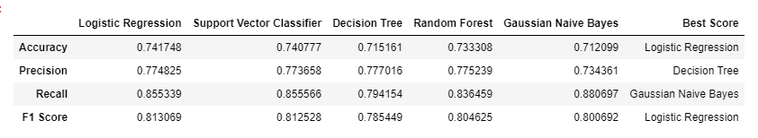
Relatively F1 Score is high and the accuracy is high in Logistic Reg F1 Score is best if there is some sort of balance between precision (p) & recall (r) in the system

Slide 15
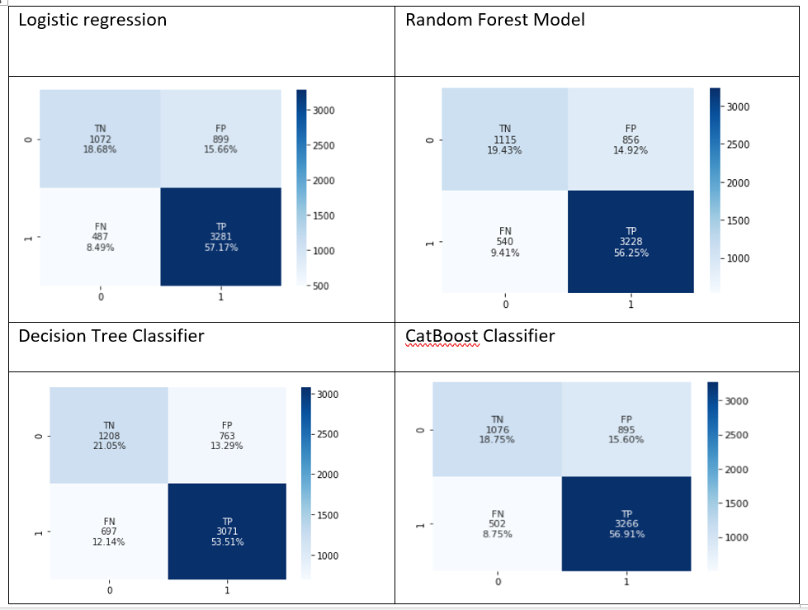
Confusion Matrix for other classifiers.
Notes:
Comparison of Matrises shows tha Logistic regression got a lower false negative value

Slide 16
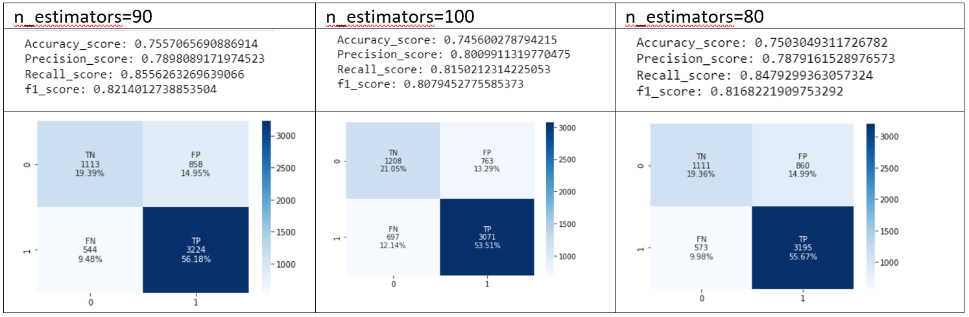
Random Forest Model (Gaussian Classifier) n_estimators=90 did the best of all three as it provided 9.48% for FN. It also shows a relatively higher Accuracy score.
Notes:
Random forest model was also trained with different estimators

Slide 17
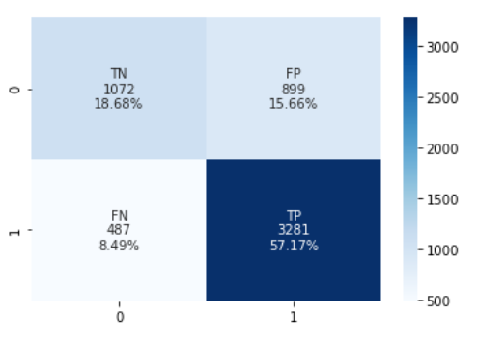
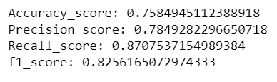
Best classifier so far is Logistic regression

Slide 18
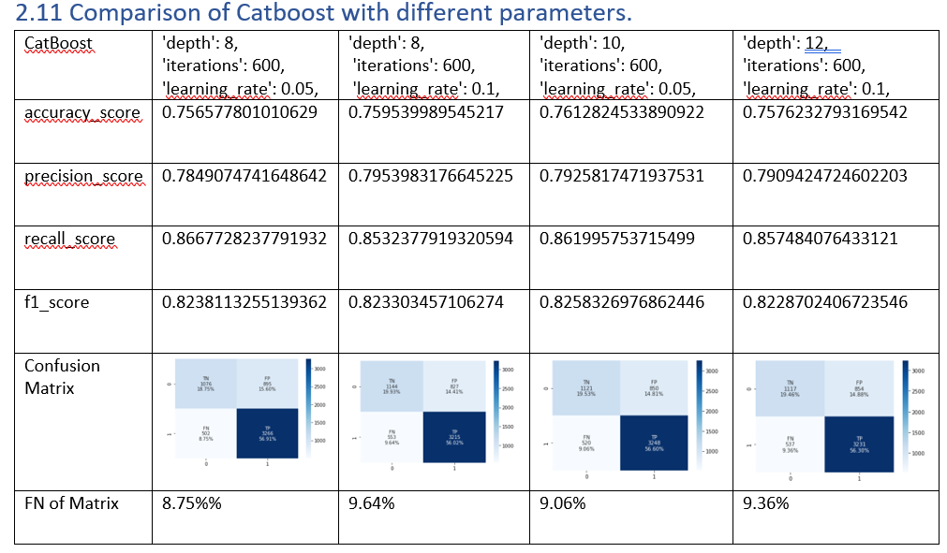

Slide 19
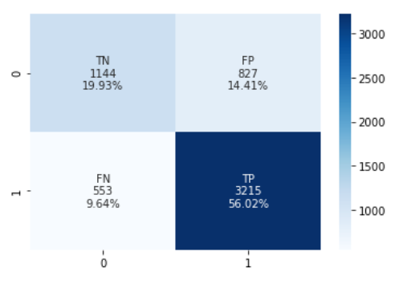
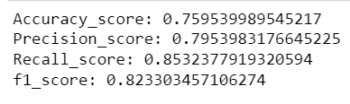
Best so far in CatBoost Classifier

Slide 20
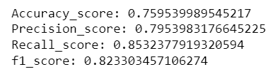
Comparison of the best outcomes.
Logistic regression
CatBoost
Notes:
As the accuracy seems slightly higher in CatBoost with a false negative 9.64%, it gets highlighted as the best for this particular instance of the dataset.

Slide 21
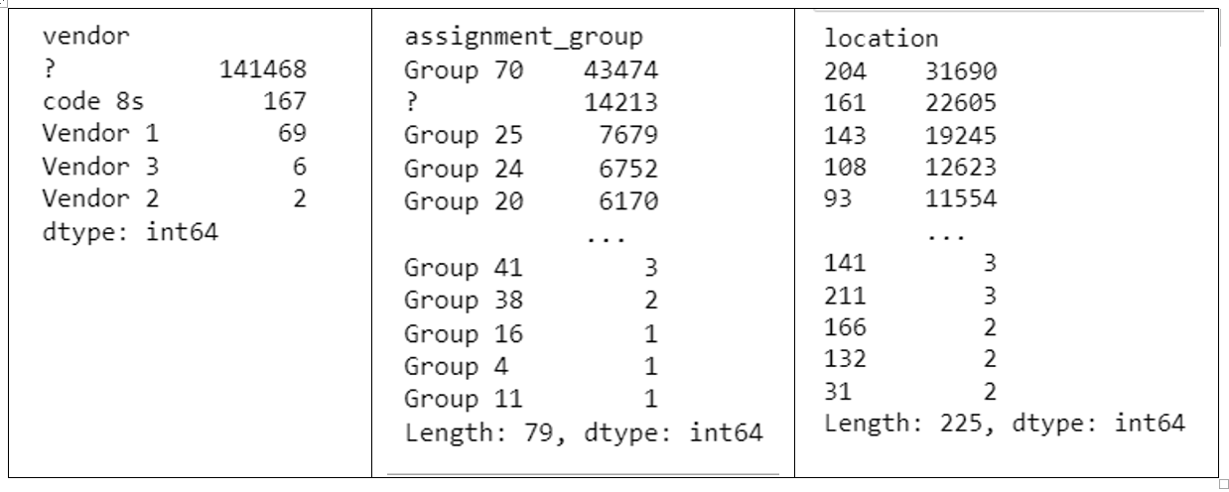
Further assessing the dataset majority of details are missing Data availability of Vendor, Assignment group and Location
Notes:
Further assessing the dataset majority of details are missing
Opportunities and possibilities predictability of the business depends on data availability.
When we look in to vendor and assignment_group there are lot of missing data.
Location on the other hand indicates that some locations are not worthy to be maintained as there are only very limited jobs from those particular areas.
That is of course due for an analysis depending on the business.

Slide 22
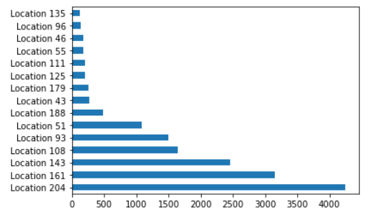
Location, Category and Group VS value counts
There are six locations clearly indicating that it is more likely to generate a new case.
Notes:
There are six locations clearly indicating that it is more likely to generate a new case.
That itself is a useful information to balance out resources in order to facilitate the incoming load.

Slide 23
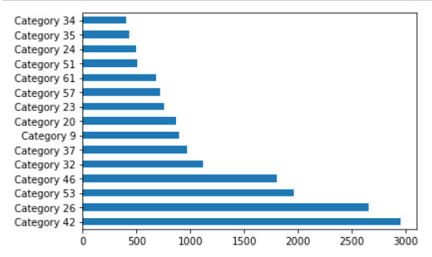
Location, Category and Group VS value counts
Categories 46, 53, 26, and 42 seems to be more popular compared to rest of the categories.

Slide 24
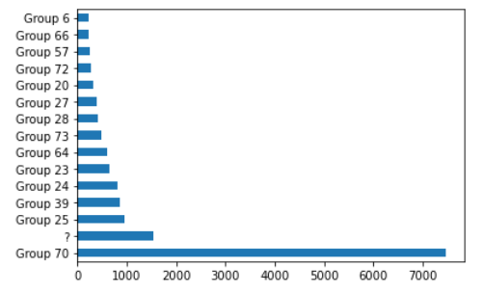
Location, Category and Group VS value counts
This graph clearly indicates that Group 70 is the busiest group out of all.
It also shows that a big percentage of group information is not entered.

Slide 25
Conclusion.
Target SLAs adherence can be met and what can be further done to reach a business’s optimal goal, can be predicted
Given example dataset indicated that CatBoost is the best training classifier with the accuracy of 75.9% to predict its Target SLAs.
All customer facing businesses can be benefitted from this project.
Recording and training data and identifying further needed data can optimise most customer-oriented businesses to their best.
Related domains of business are retail, call centres, receptions of offices, hotel and tourism industry and many more.
Notes:
Accurecy 0.7628506708485799

